Slide 1

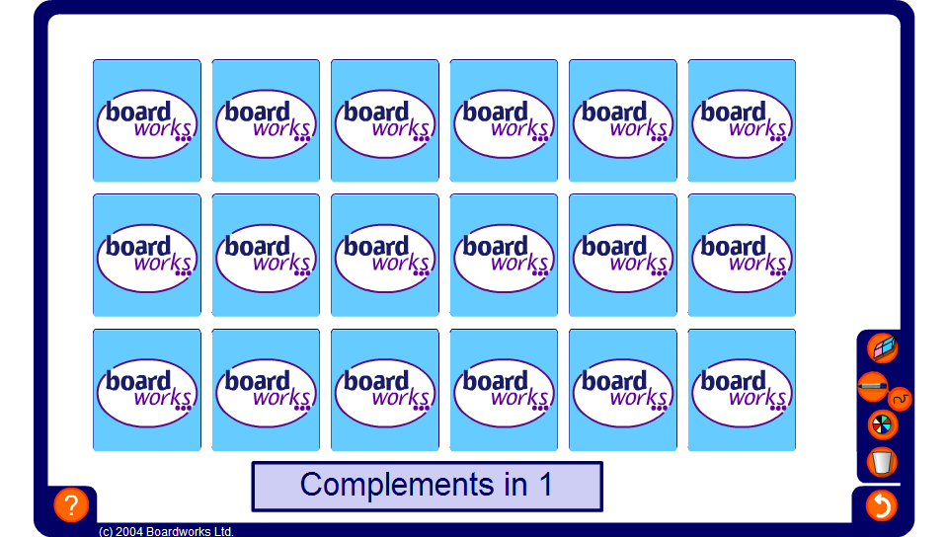


Complements match
Notes:
Explain to pupils that when we are adding it is often useful to look for complements in 1 (for adding decimals) and 10, 50, 100 and 1000 for adding larger whole numbers.
Numbers can be broken apart mentally to make complements. For example, 5.4 + 3.7 = 5.4 + 0.6 + 3.1 = 6 + 3.1 = 9.1
This activity practises identifying complements. Challenge pupils to match pairs of cards as quickly as possible. When the first card is revealed ask pupils to tell you what its complement is before trying to find it.
By clicking on the blue bar you can choose to match complements in 1, 10, 50, 100 or 1000.

